Slide 1
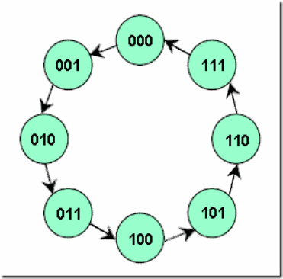
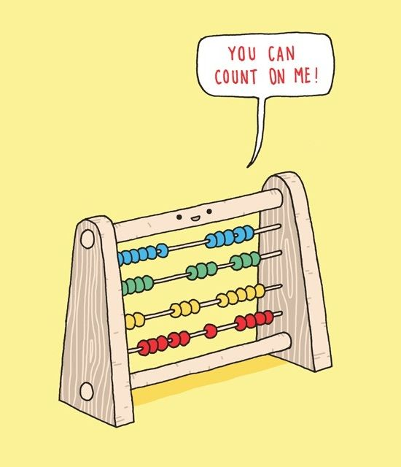
COUNTERS
Chapter 9
Week 1
Sumaiyah Zahid

Slide 2
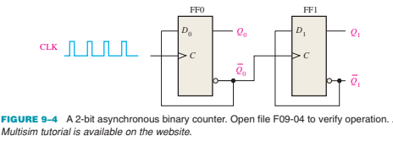

Asynchronous Counters
In asynchronous counter flip-flops (FF) do not change states at exactly the same time because they do not have a common clock pulse.

Slide 3
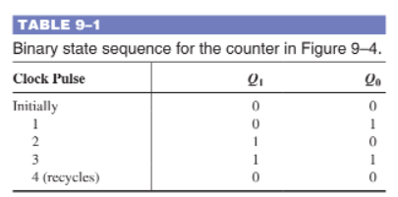
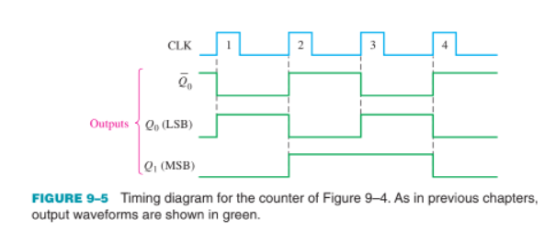
Asynchronous Counters

Slide 4
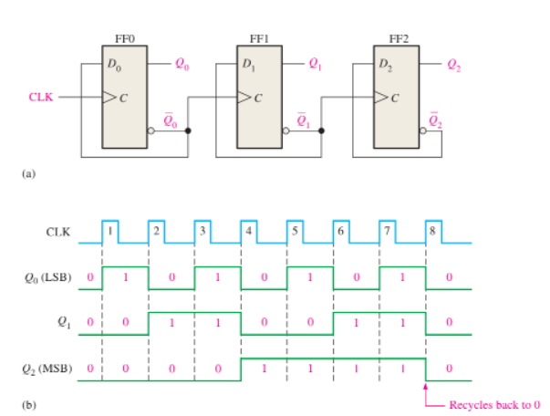
3-Bit Asynchronous Binary Counter

Slide 5
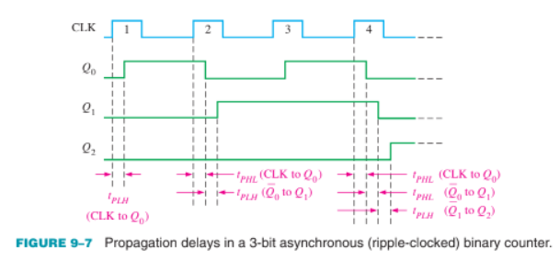
Propagation Delay

Slide 6
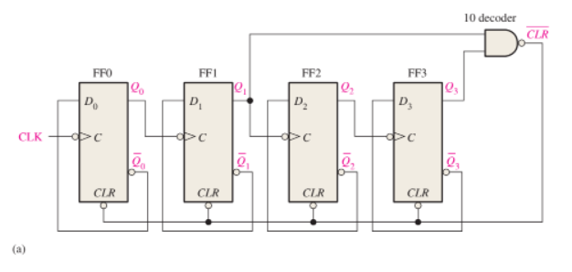
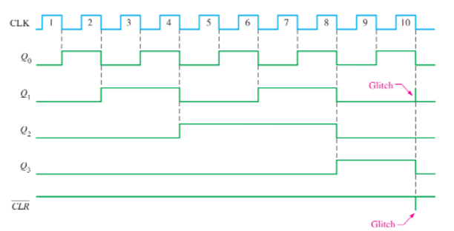
Asynchronous Decade Counters

Slide 7

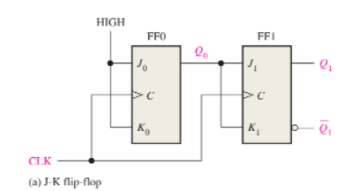
Synchronous Counters
In synchronous counter all the flip-flops in the counter are clocked at the same time by a common clock pulse.

Slide 8
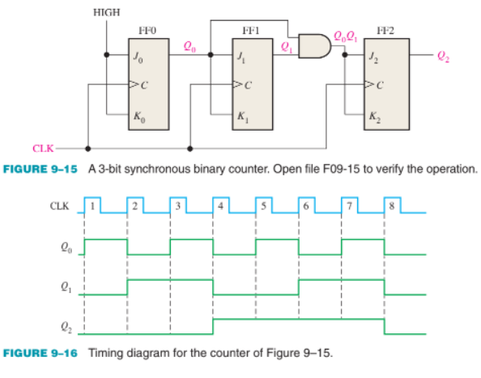
3-Bit Synchronous Binary Counter

Slide 9
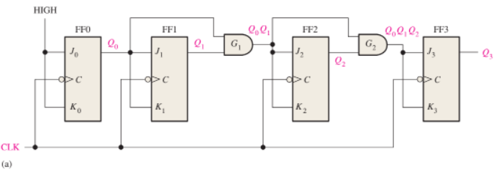

4-Bit Synchronous Binary Counter

Slide 10
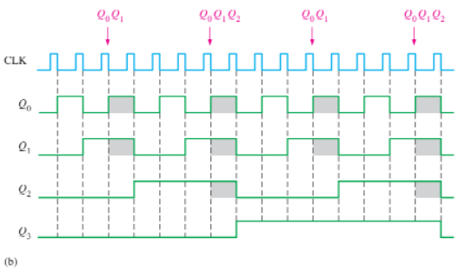
4-Bit Synchronous Binary Counter

Slide 11
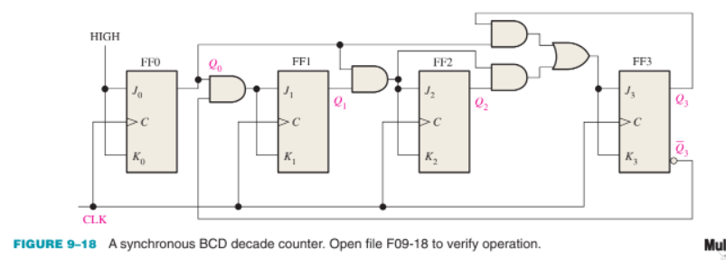
4-Bit Synchronous Decade Counter

Slide 12
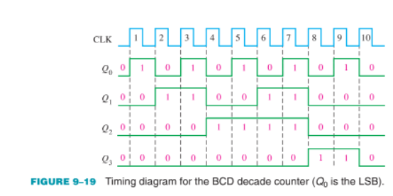
4-Bit Synchronous Decade Counter

Slide 13
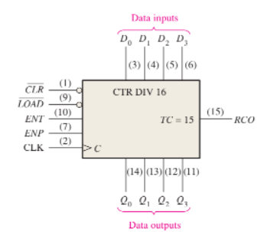
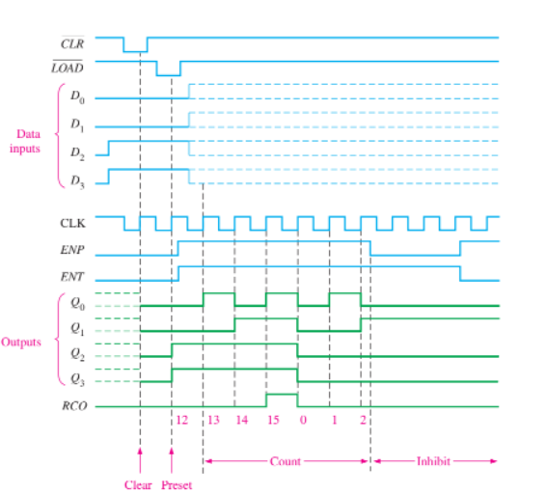
4-BIT SYNCHRONOUS BINARY COUNTER

Slide 14
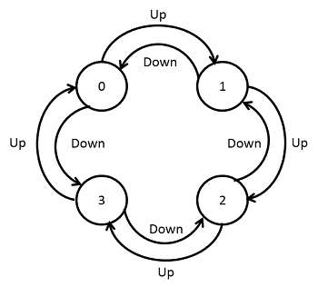
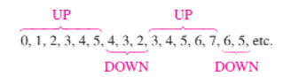
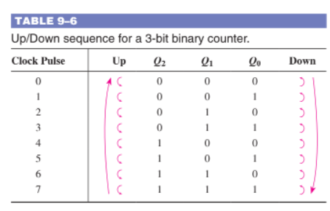
Up/Down Synchronous Counters
Also called a bidirectional counter.

Slide 15
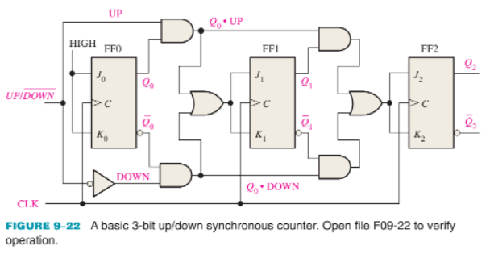
Up/Down Synchronous Counters

Slide 16
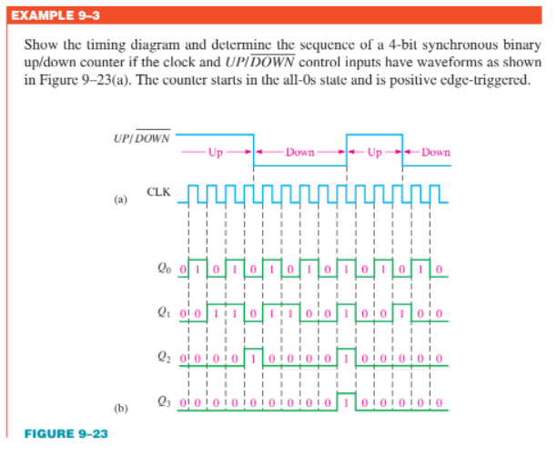
Up/Down Synchronous Counters

Slide 17
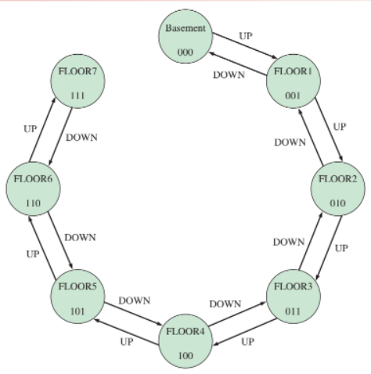
Up/Down Synchronous Counters
Applications
Elevators

Slide 18
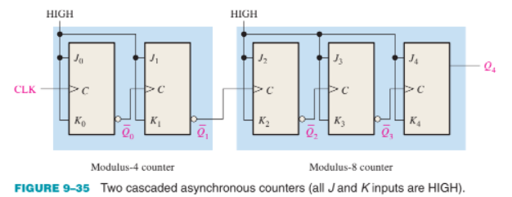
Cascaded Counters
Asynchronous Cascading
Total states = 4*8=32

Slide 19
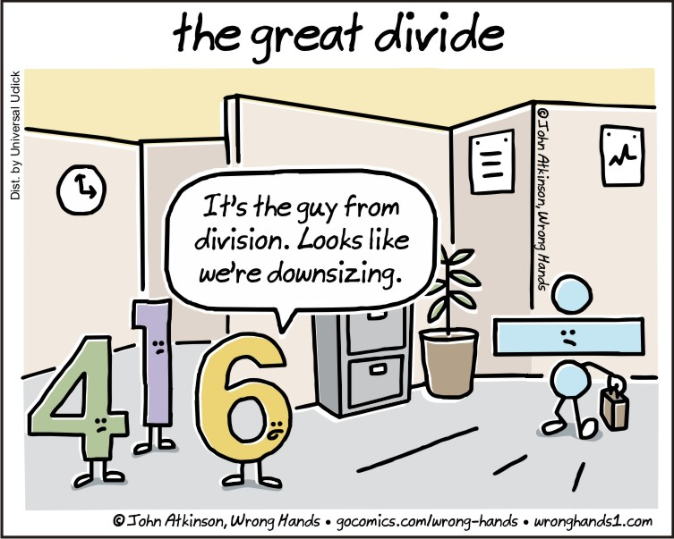
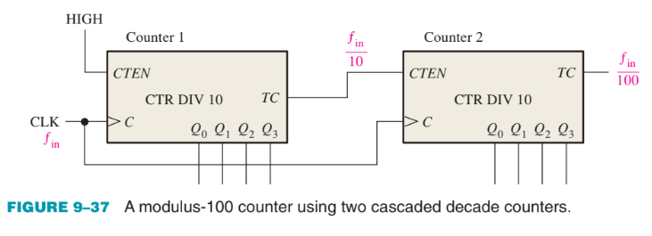
Cascaded Counters
Synchronous Cascading
Total counts = 10*10=100

Slide 20
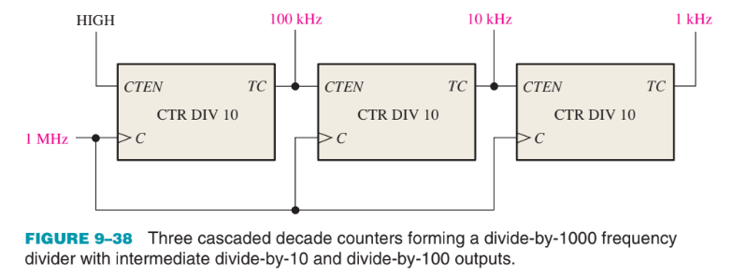
Cascaded Counters
Synchronous Cascading
Frequency division by 10*10*10= 1000

Slide 21
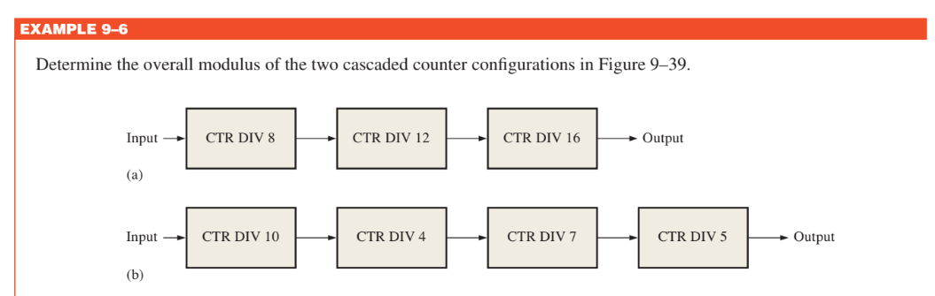
Cascaded Counters

Slide 22
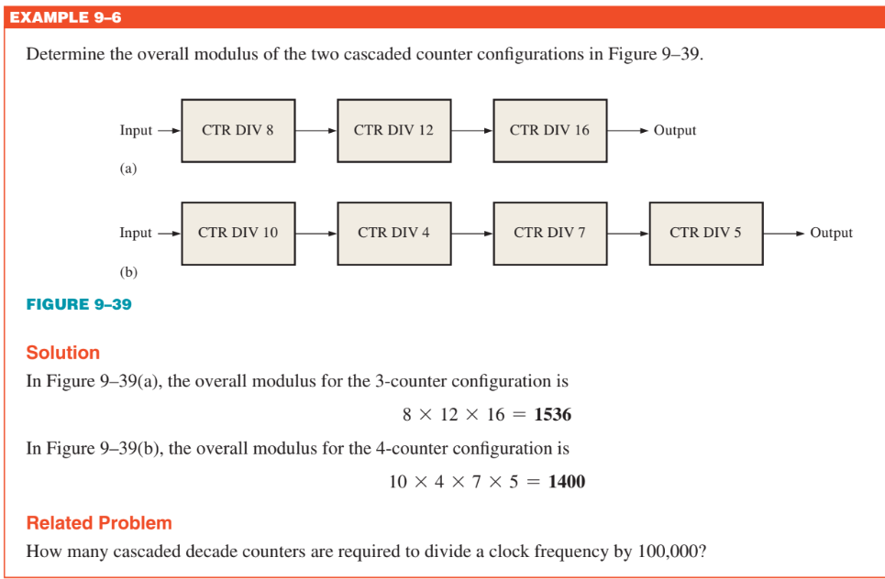
Cascaded Counters

Slide 23
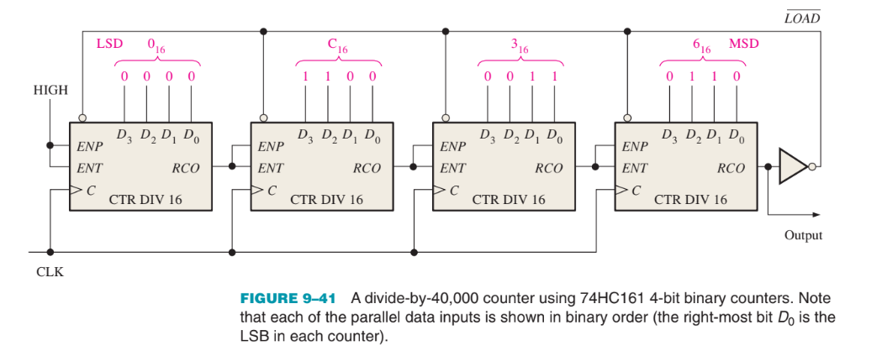
Cascaded Counters
Cascaded Counters with Truncated Sequences

Slide 24
Cascaded Counters
Cascaded Counters with Truncated Sequences
Also known as full-modulus cascading.
2^16 = 65536
65536 - 40000 = 25536 (63C0 in Hex)
25536 states should be deleted.

Slide 25
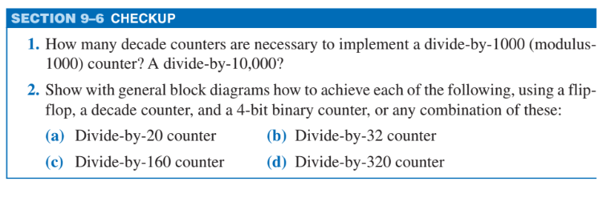
Cascaded Counters

Slide 26
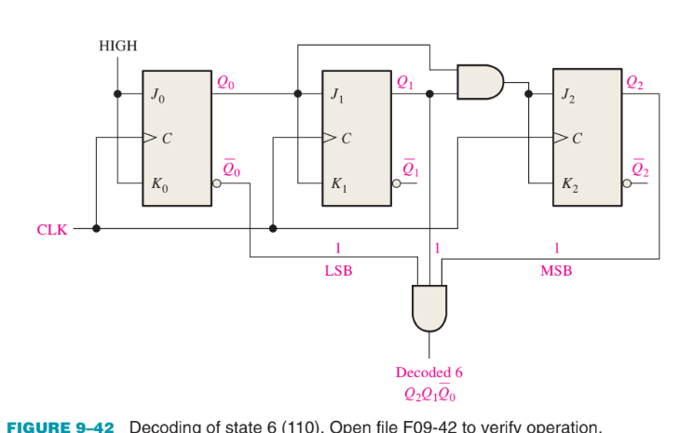
Counter Decoding
Active HIGH Decoding
Active Low Decoding
Will use NAND

Slide 27
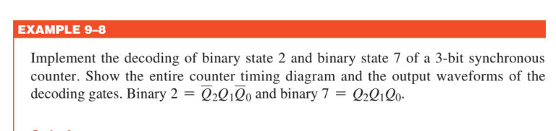
Counter Decoding

Slide 28
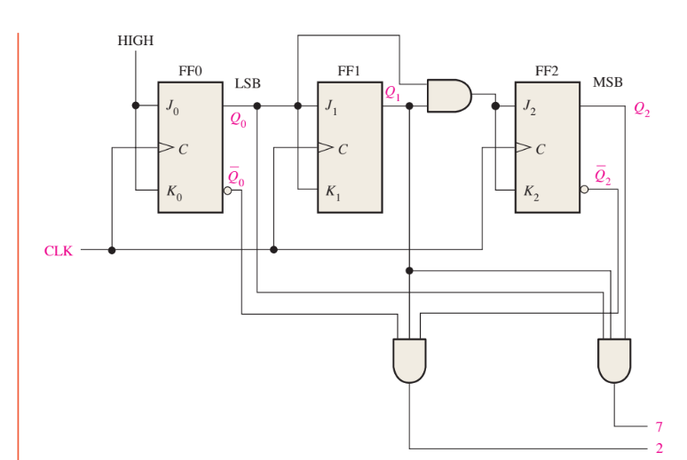
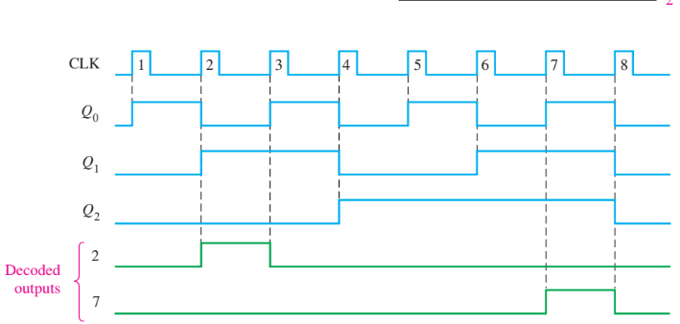
Counter Decoding

Slide 29
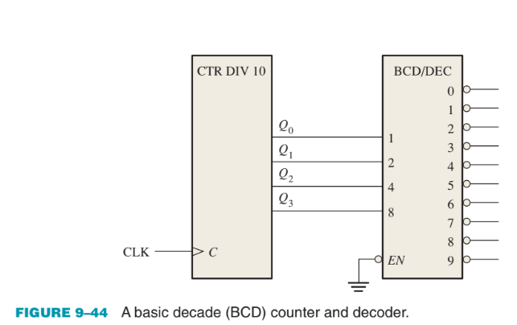
Counter Decoding

Slide 30
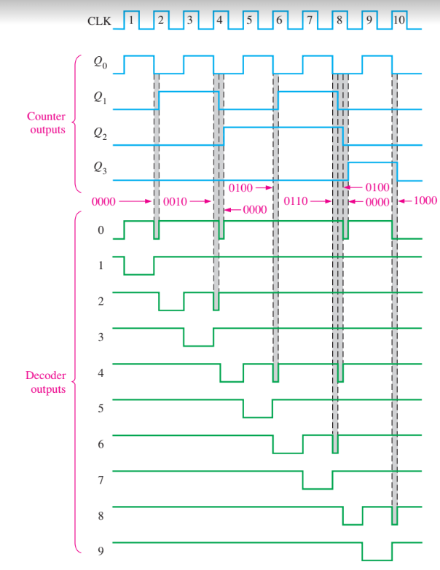
Counter Decoding

Slide 31
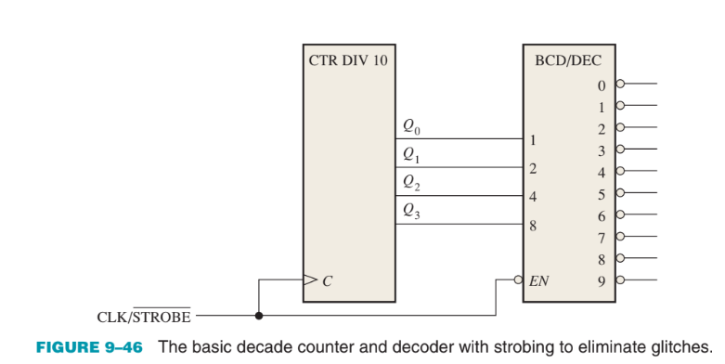
Counter Decoding ~ Strobing

Slide 32
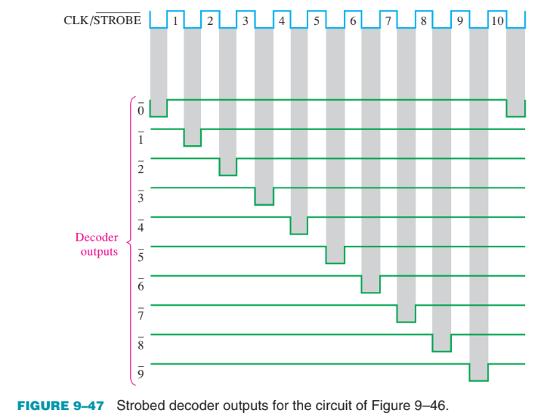
Counter Decoding ~ Strobing

Slide 33
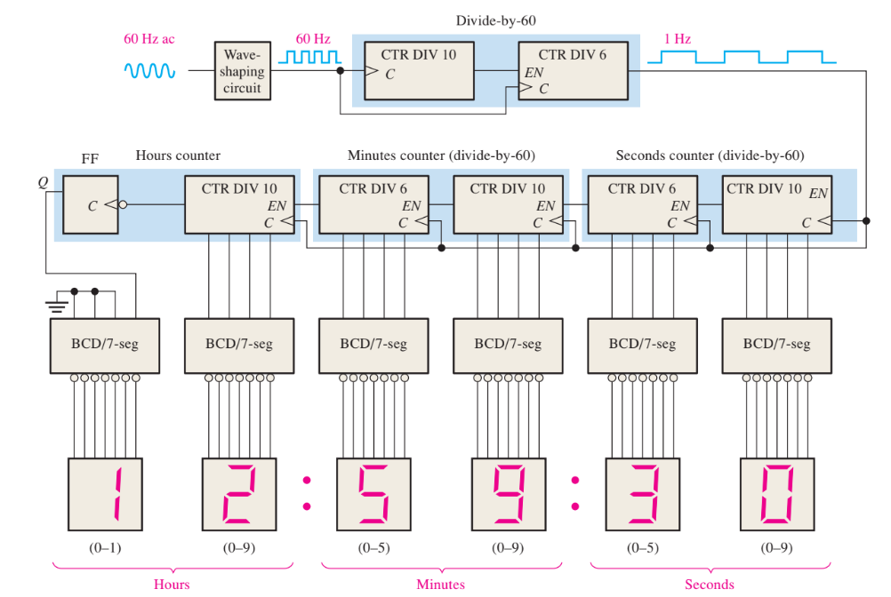
Counter Applications
A Digital Clock

Slide 34
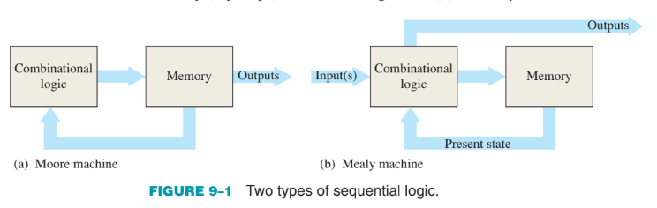
Finite State Machines
A state machine is a sequential circuit having a limited (finite) number of states occurring in a prescribed order.
Moore
outputs depend only on the internal present state
Mealy
outputs depend on both the internal present state and on the inputs

Slide 35
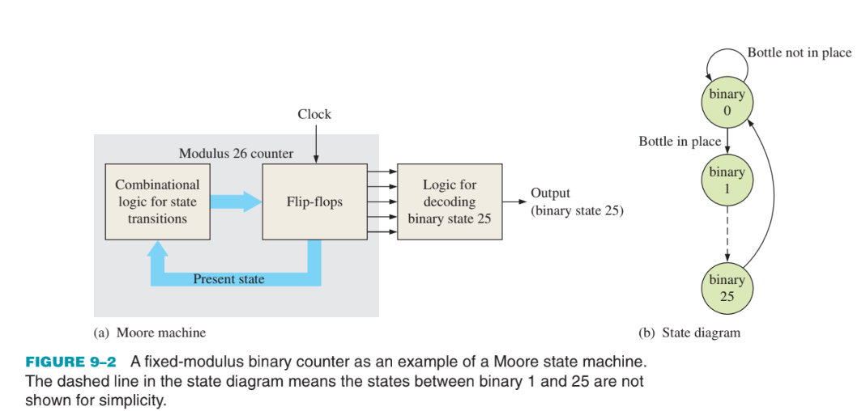
Moore Machine

Slide 36
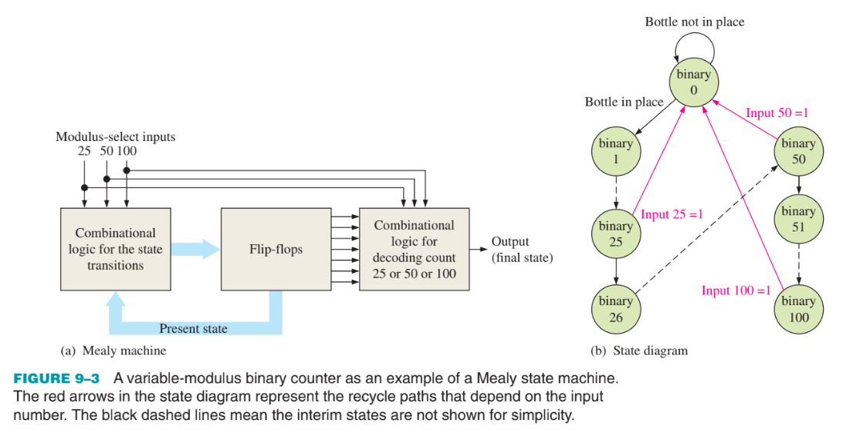
Mealy Machine

Slide 37
Designing A State Machine
Step 1: State Diagram
Step 2: Next-State Table
Step 3: Flip-Flop Transition Table
Step 4: Karnaugh Maps

Slide 38
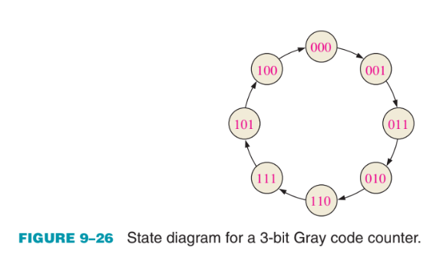
Step 1: State Diagram

Slide 39
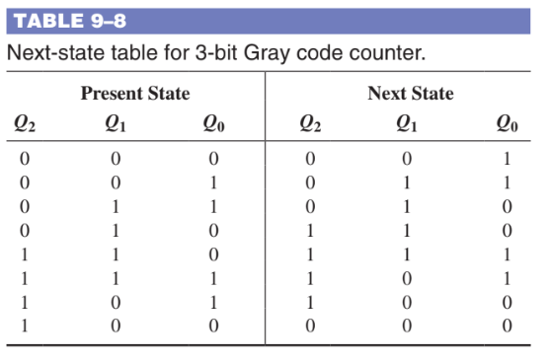
Step 2: Next-State Table

Slide 40
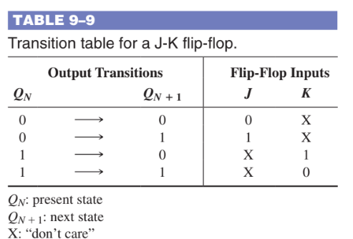
Step 3: Flip-Flop Transition Table

Slide 41
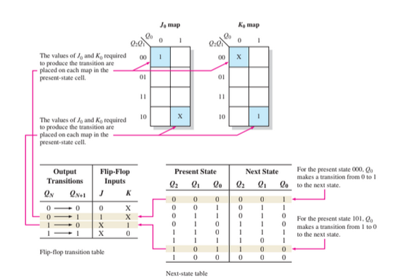
Step 4: Karnaugh Maps

Slide 42
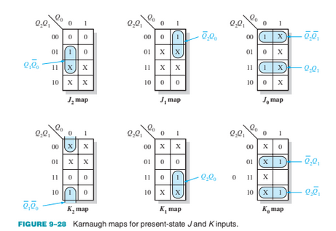
Step 4: Karnaugh Maps

Slide 43
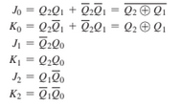
Step 5: Logic Expressions for Flip-Flop Inputs

Slide 44
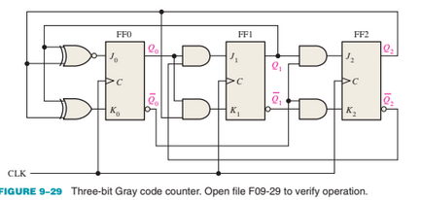
Step 6: Counter Implementation

Slide 45


Synchronous Counters

Slide 46



Slide 47

Synchronous Counters

Slide 48

Synchronous Counters

Slide 49


Slide 50


Slide 51


Practice Questions

Slide 52

Counter Applications
Automobile
Parking Control

Slide 53

Counter Applications
Parallel-to-Serial
Data Conversion
(Multiplexing)

Slide 54
End is the new Beginning
Best of luck for your future

Slide 55
It’s been a nice journey with you guys

